Slide 1
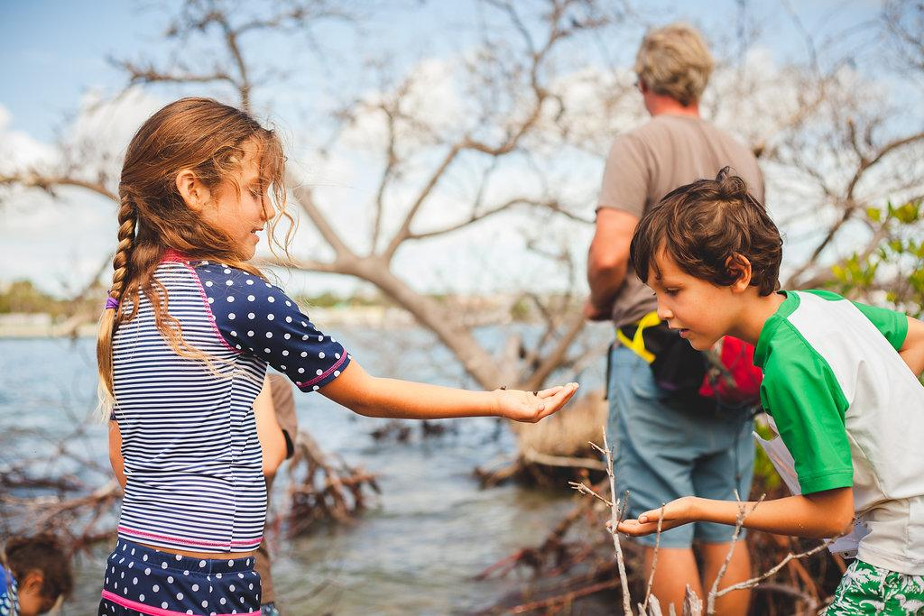
Finding a Sense of Place
Inspiring awe and wonder through outdoor, place-based learning

Slide 2
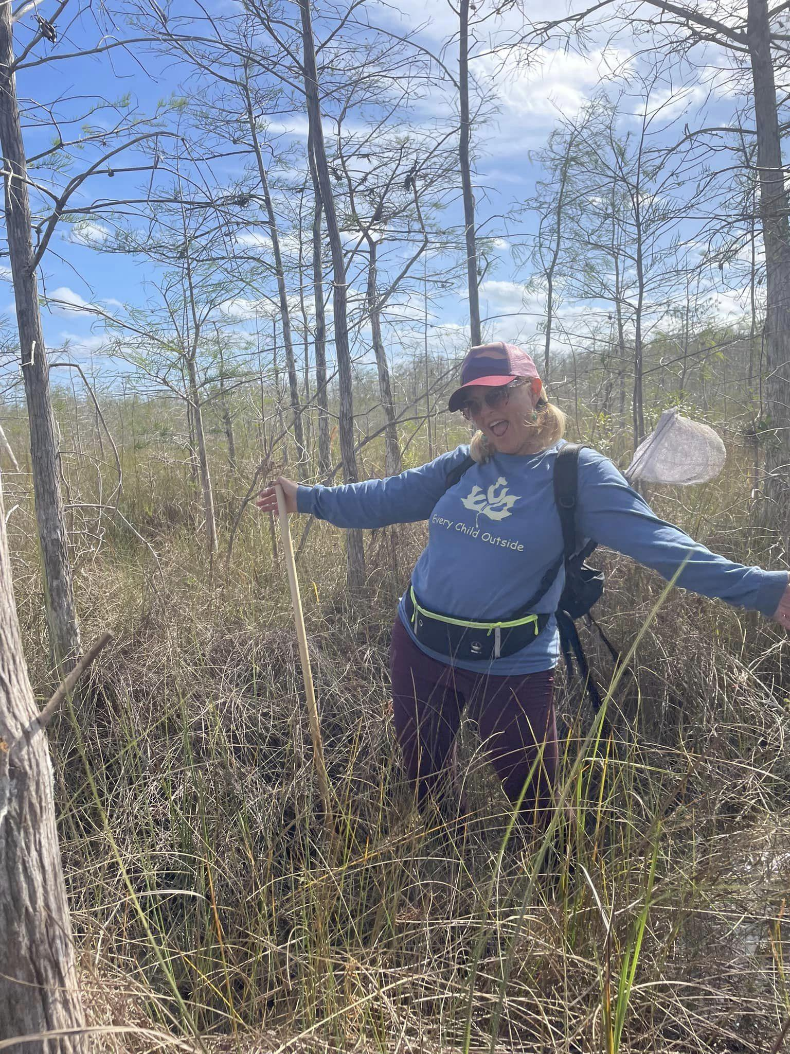
Engage
Welcome, I am Christy Schultz, Co-Owner and Director of Take Root Forest School. Follow me as we take an experiential adventure through the wild and wonderful world of Nature and Place-based Learning.

Slide 3
Gratitude
Before we begin, let’s take a moment for gratitude…
“…as always, I thank the ancestors, those who have gone on and those who are always arriving.” (We Are the Ones We Have Been Waiting For, Alice Walker, 2007).
Let us honor those who were here before us, thousands of years on this land…the ancient people who left behind hills of shells, the Tequesta peoples that came after. The Seminoles and Miccosukees who fought to stay.

Slide 4
Sense of place is the meaning of and the attachment to a place held by an individual or a community. Every experience in a place conjures up emotions that become attached to that experience. When attached to a place, those emotions define the Sense of Place.
When learners are provided an opportunity to play, explore and discover in an outdoor environment, they are often filled with awe and wonder about the natural environment and the relationships happening within. When learners are provided with ways to engage in that natural place experientially, their whole beings are awoken and all senses are engaged, leading to a positive and holistic experience with the outdoor world. When learners learn about what is happening in that place, they tend to embrace the wholeness of the world around them and are able to not only develop their sense of place, but their sense of self.
This happens in outdoor learning, in Forest School, and any experiential process outside, especially if intentional.
An experience is created, engaging the whole-person, creating connection. Today, in the brief time we are together, we will experience an adventure through natural Florida. Connection will be formed using reflection and meditation, song and movement, story and imagination, and finally, involvement through further experience and immersion.

Slide 5
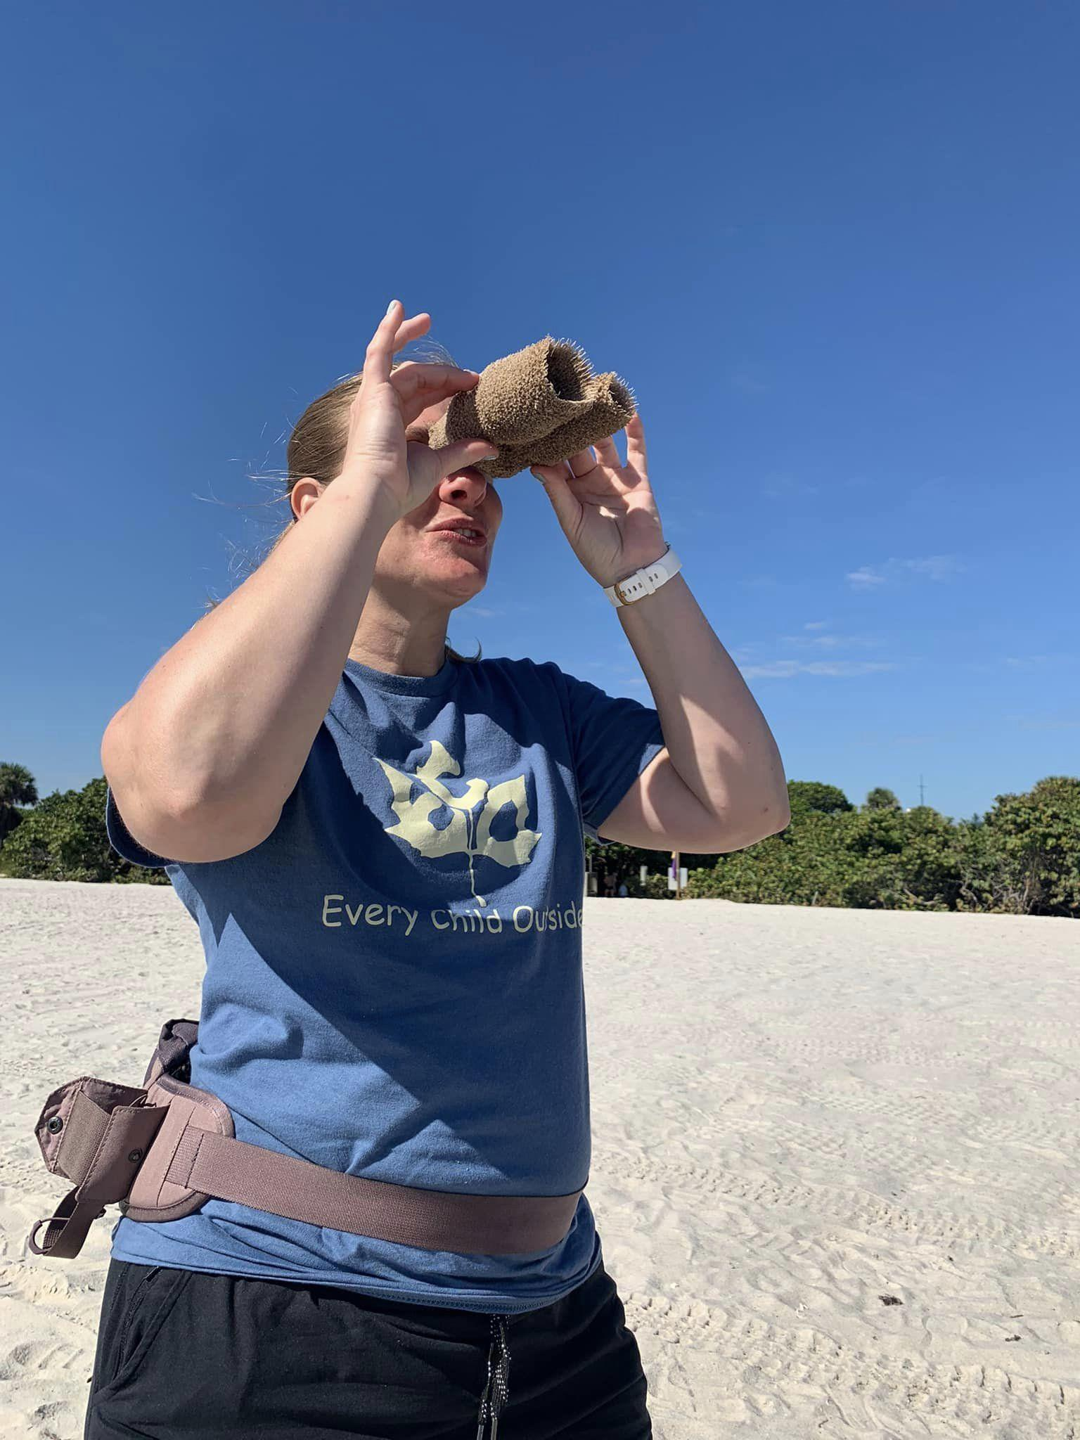
VISUALIZE…where would you like to be? Think of a beautiful, natural area here in Florida that you love. Let’s imagine being in that place.
Close your eyes and go there in your mind. Now, let’s sit and listen as I share

Slide 6
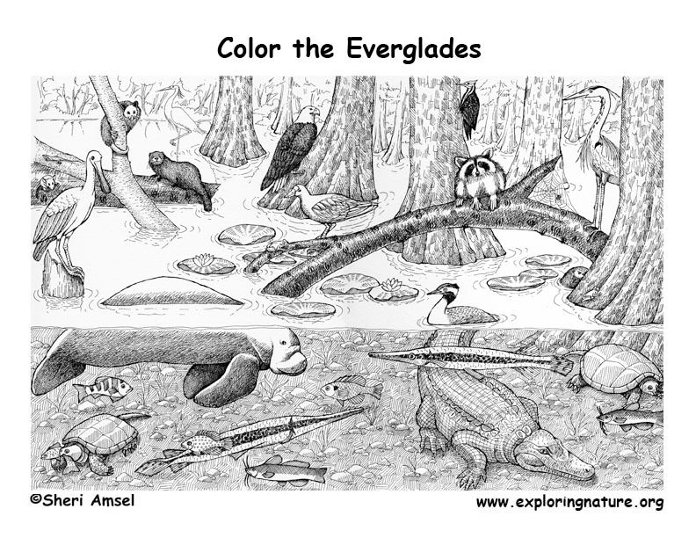
The Everglades
Campbell McGrath
Green and blue and white, it is a flag for Florida stitched by hungry ibises.
It is a paradise of flocks, a cornucopia of wind and grass and dark, slow waters.
Turtles bask in the last tatters of afternoon, frogs perfect their symphony at dusk—
in its solitude we remember ourselves, dimly, as creatures of mud and starlight.
Clouds and savannahs and horizons, its emptiness is an antidote, its ink
illuminates the manuscript of the heart. It is not ours though it is ours
to destroy or preserve, this the kingdom of otter, kingfisher, alligator, heron.
If the sacred is a river within us, let it flow like this, serene and magnificent, forever.

Slide 7
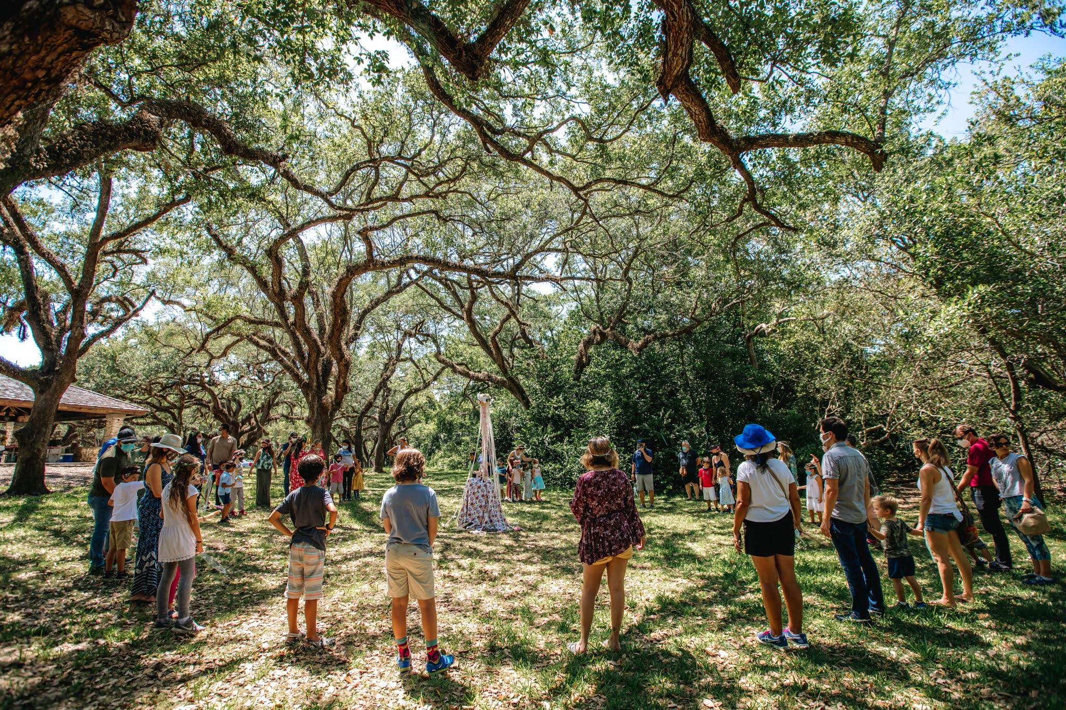
Circle Round

Slide 8
Sing - let’s join together
Green trees around us
Blue skies above
Friends all around us, let’s make a circle with love
The birds fly above us
The ants crawl below
Friends all around us, let’s stand and say “hello”

Slide 9
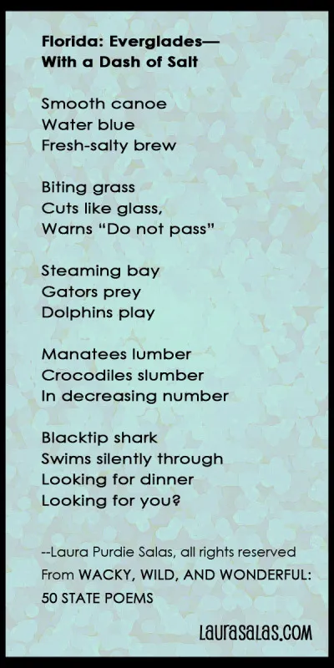

Slide 10
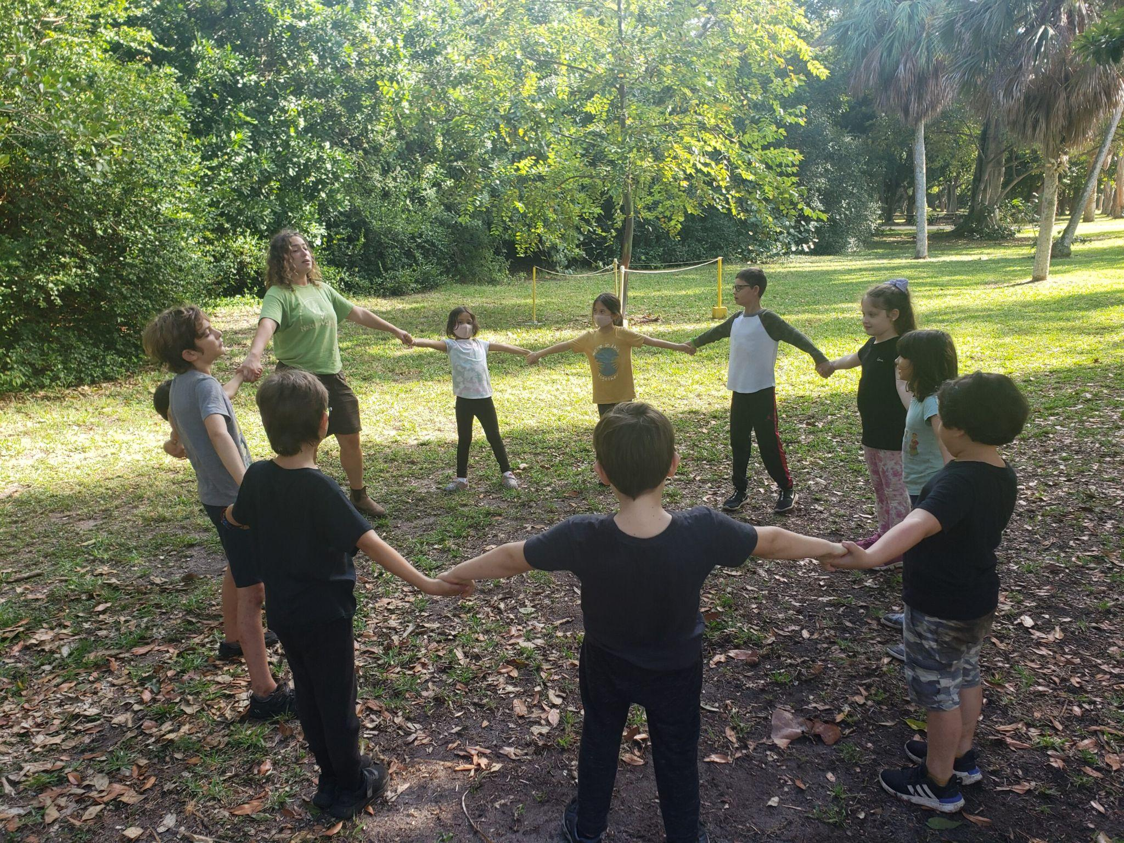
Move

Slide 11
Become
Travel in your canoe, rolling and rocking
Be the heron that you see in the distance, standing tall and still in the shallow waters, waiting, zen-like to catch a tiny fish with its sharp beak
Now become the tall tree that the heron flies to, resting after the hunt
Travel below the tree to the dry ground and bask in the sun like the alligator
Crouch like a frog in the shallow wetlands
Be still like the seed, waiting to sprout
Raise your face to the sun and emerge from your pod, stretching your branches out and your leaves to the sun
Ground your feet to the earth and TAKE ROOT!

Slide 12
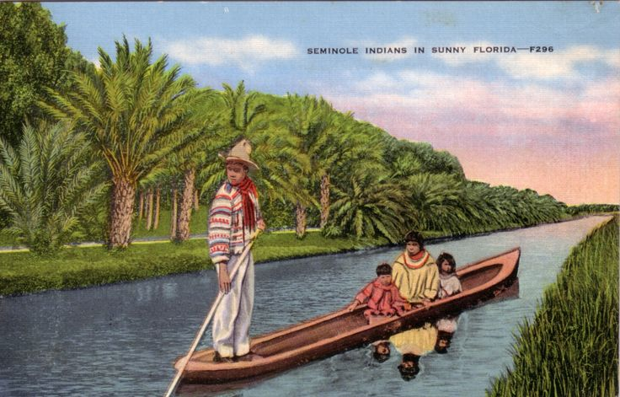
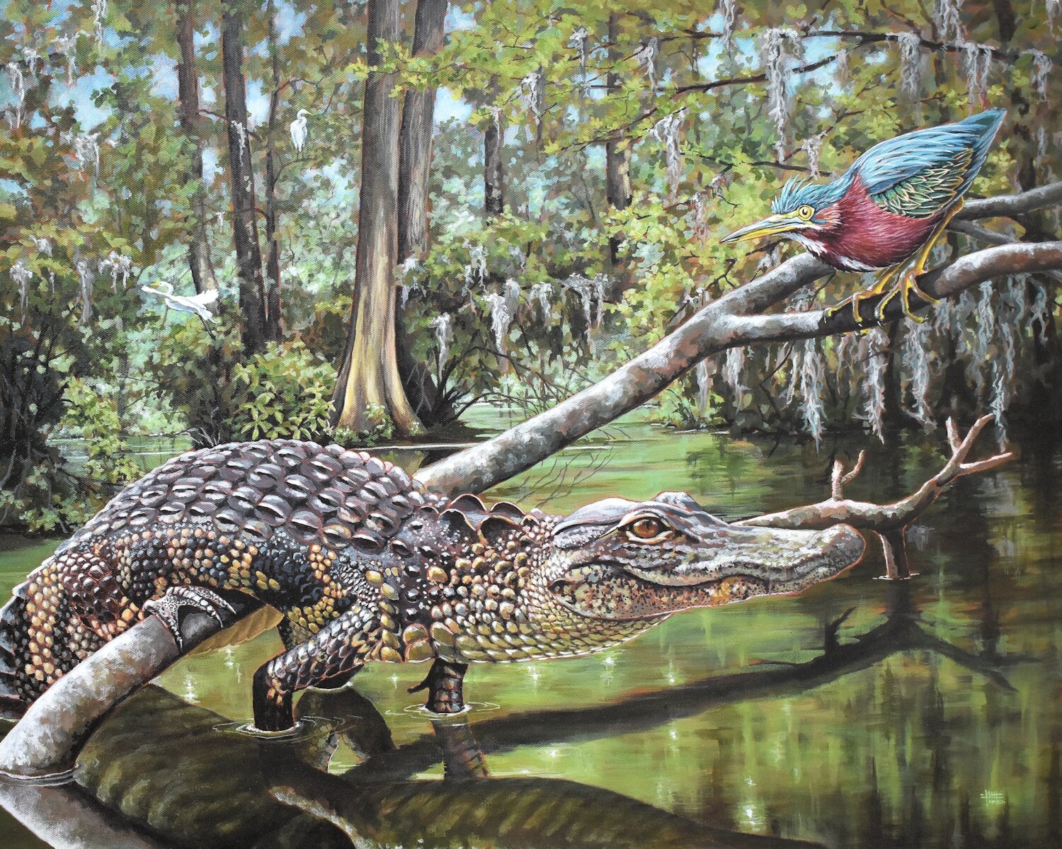
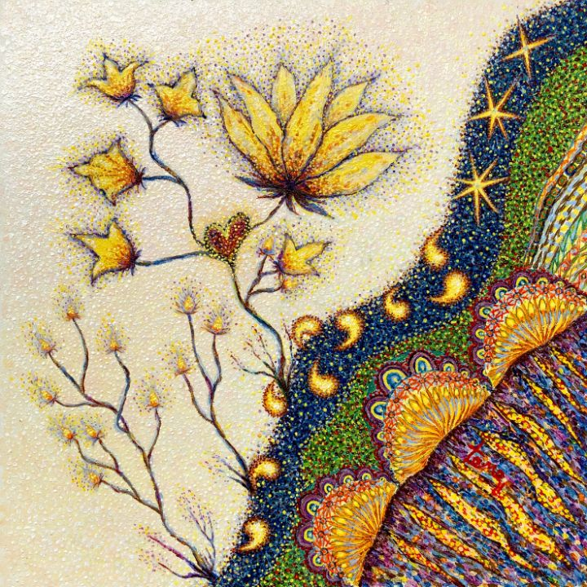
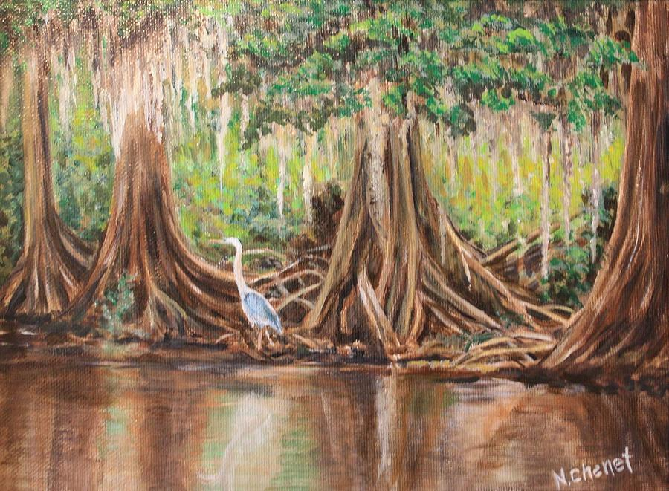
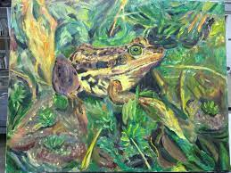

Slide 13
Sing
My roots go down, down into the earth.
My roots go down, down into the earth.
My roots go down, down into the earth.
My roots go down.
My trunk goes up, up into the world…
My branches go out, out into sky…
My leaves go out, out into the sun..

Slide 14
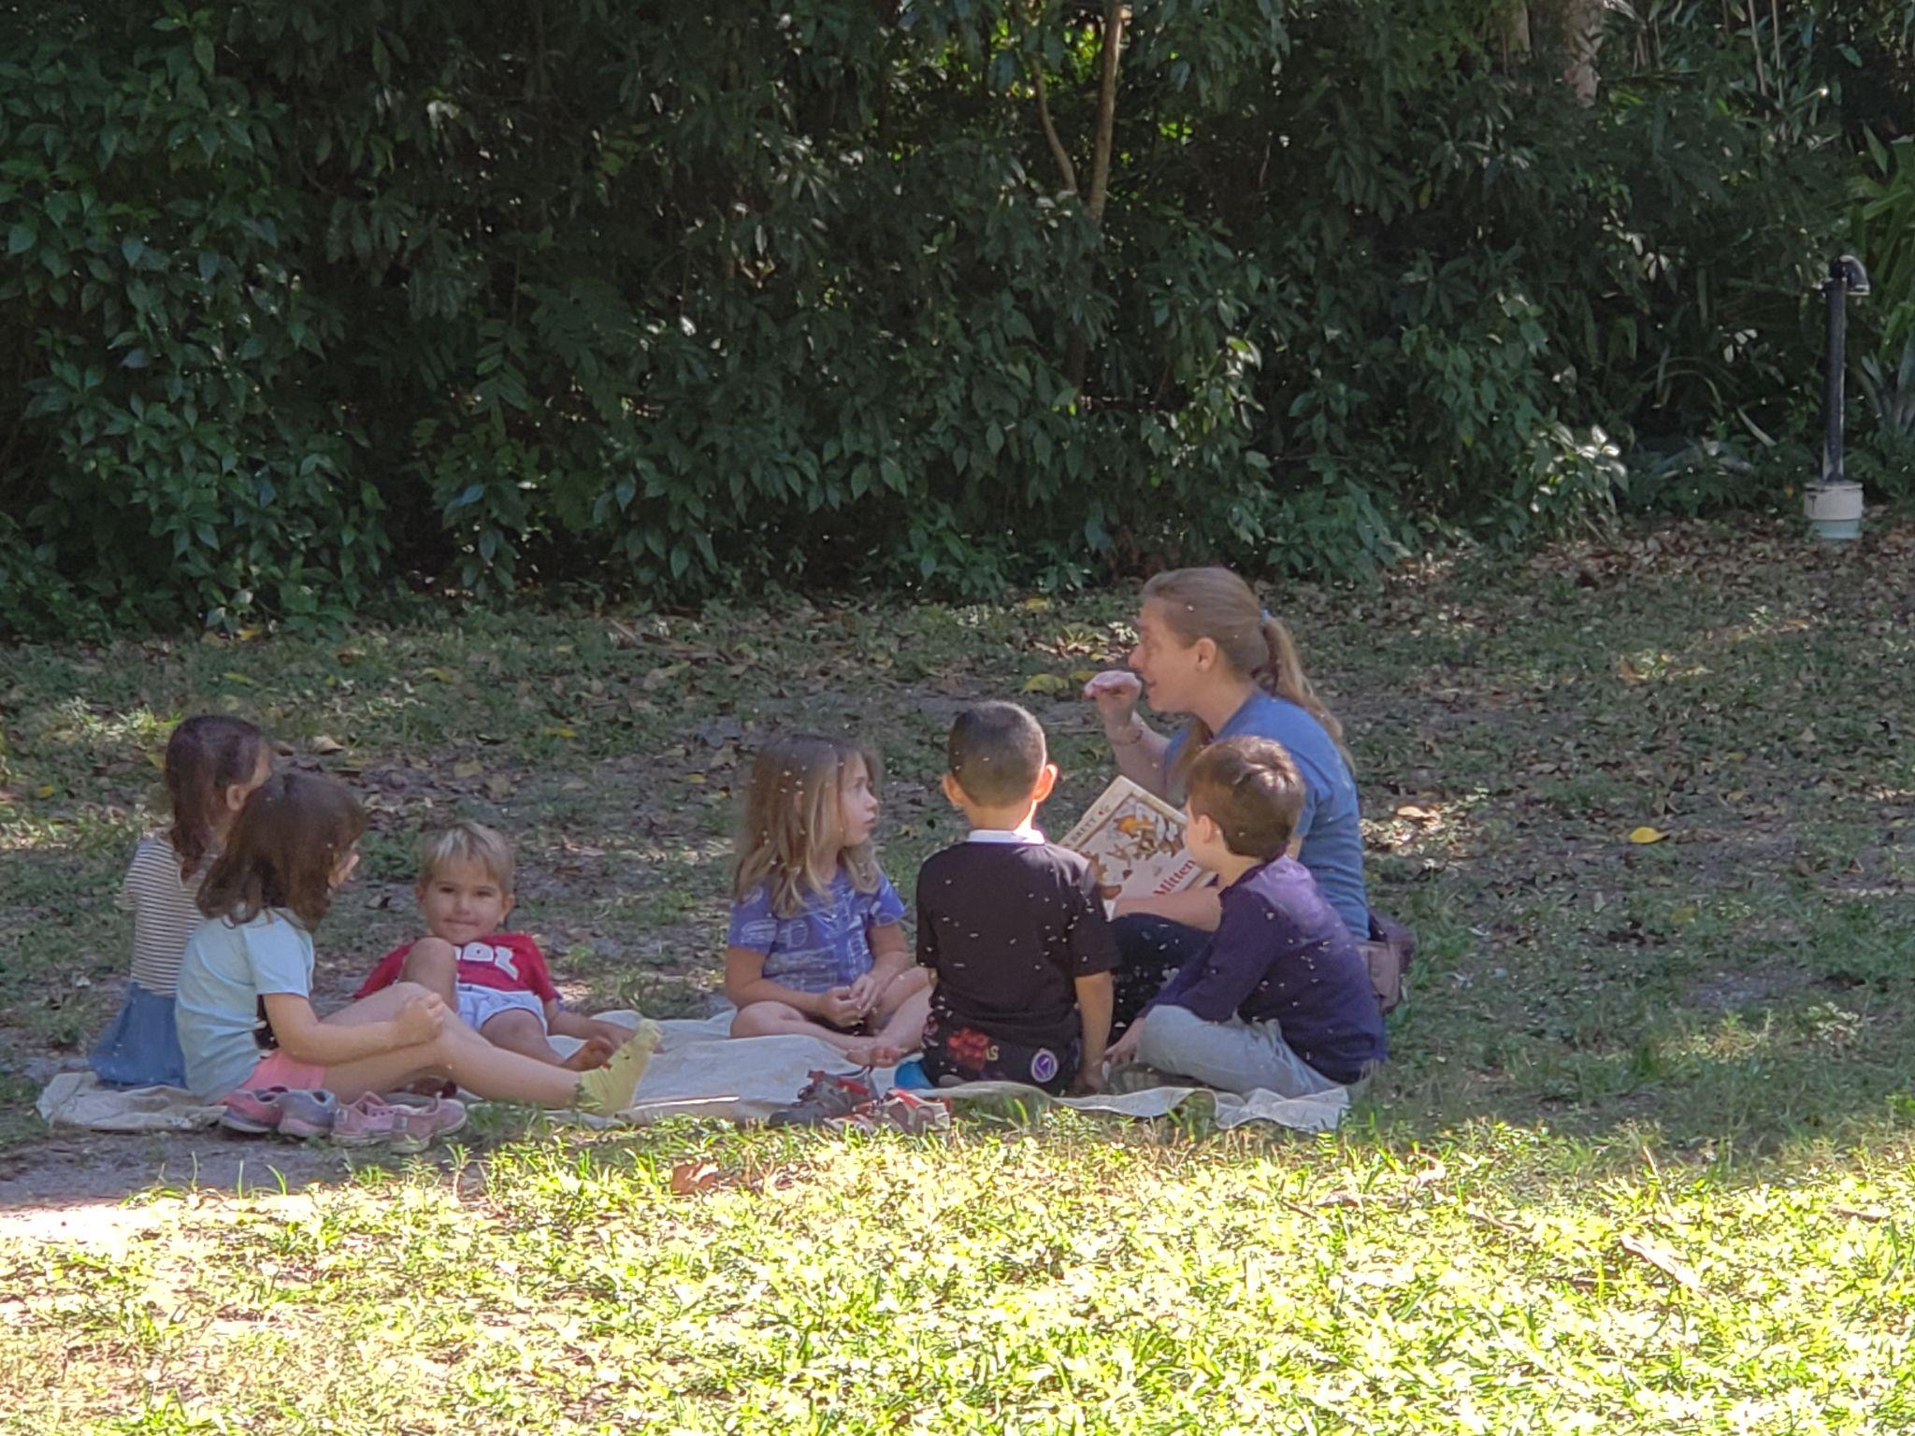
Story Time

Slide 15
Listen
Once upon a time (and many times before)...so many thousands of years ago that it is barely in our collective memory - our dreamtime - our story, the land we now call Florida, rested beneath a shallow ocean.
Flying in the sky above that sea, on occasion, a lone Osprey would often hunt - traveling just off-shore, on the search for fresh fish for supper.
I invite you to close your eyes and travel back in time to that shallow ocean. Become a part of that place - that warm, azure sea. Are you an animal? A plant? A bacteria? A drop of water? WHAT ARE YOU? What does it feel like, what do you see, what do you smell, taste? Are you flying alongside our friend, the Osprey? Or do you see him above you flying and diving? Travel with him and keep him in sight as we adventure through time…
You are drifting or floating or swimming or flying. You can feel the warmth of the sun or the splash of cold rain, the vibration of a lightning bolt nearby, or the mad swirl of wind as a hurricane passes. You are a part of the warm sea, surrounded by the colors of a gazillion plankton, a thousand fishes, brilliant octopuses, a rainbow of corals.
Swish, a large megalodon speeds past, seals and whales frolic. Our friend, the Osprey, pauses and dives in a rush toward the surface of the sea, grabbing energy from the bountiful life of the sea. He spares you so you can tumble through time with him.

Slide 16
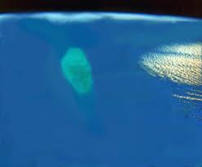
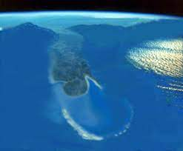
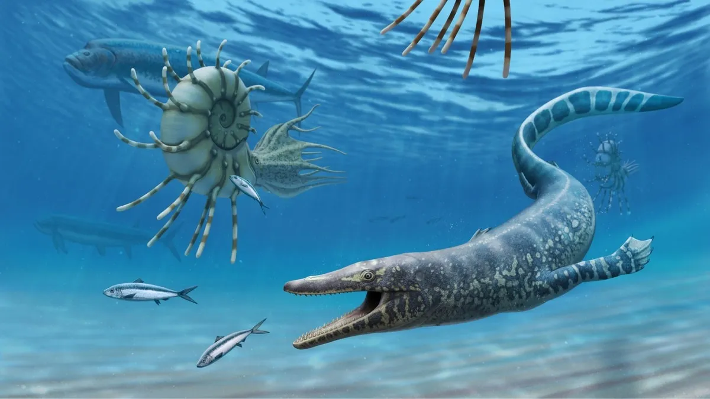
Ancient Florida - 36-40 million years ago

Slide 17
Our Story
Spinning through a vortex, you and the Osprey travel. Like magic. Ages pass, thousands and thousands of years of the cycle of life in which organisms live and die, leaving behind their skeletal remains. Piles of calcium carbonate, dissolving and stacking and piling up - becoming the limestone bedrock of Florida. Deep, deep beneath are the bones of ancient beings, and just below, under our toes - the remains of a more recent story.
Exploding through the vortex of time, you and Osprey land in a very different place. The water of this sea is cold and deep, and the shallow reefs just an ancient memory. You see land in the near distance - a high plateau of windswept grasses and plains.
Such a tremendous amount of time has passed since you were last in this place, In that time, the ocean has ebbed and flowed and became colder and colder, receding and exposing the land and left-behind coral reefs, The land is wide and vast and stops at the ocean where it plunges to depths of thousands of feet - a mountain below.
You and Osprey are confused and don’t understand how this happened. You were just here and it was so different!
In time, you learn the story from the creatures of the sea and land. They whisper it to you in the wind and tell tales of giant icebergs covering the northern seas, and snow and glaciers covering the northern lands. Fantastic tales are told of herds of ancient creatures fleeing southward to the dry, flat plains of the land we now call Florida.
Osprey is hungry and heads out for the hunt, searching for a shallow lake or stream full of fishes. He heads inward toward land, toward the mass migration. You need to follow.

Slide 18
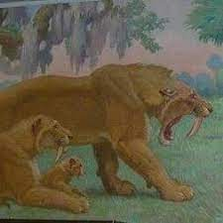
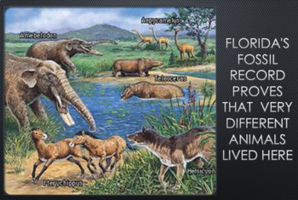
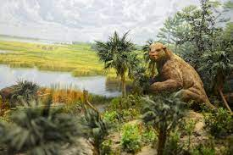
Ancient Beings

Slide 19
Travel through Time
Imagine being there in that place. WHAT ARE YOU? Mammoth? Giant Sloth? Saber Tooth Tiger? Become that creature, running south to the warmer winds of Florida - chasing energy; being chased, living in a Florida you might not recognize - one of cold dry air and windy plains.
Ages pass. Ancient animals' bones are left behind, buried under the earth, waiting to be found in some future time. The earth tilts toward the sun, the air warms and the seas rise as the glaciers melt. Rain falls. And Falls and falls. Water everywhere. The land becomes covered in sparkling, clear fresh water. You and Osprey spin through time and land in a wet and watery world. All around you is the sound of water. The water drip, drip, drips down through the earth, percolating beneath the soil, eroding its way through the porous limestone, plopping and plipping, leaving behind holes and pockets in the ancient bones.
You become part of this place, but this time, before you can decide, you realize you are a drop of water in this wet place!
Suddenly, you feel the land beneath you quake, you splash up and land on the leaf of a tree where Osprey is perched. You watch as the land below you sinks away, leaving behind a hole in the earth like a giant’s footprint. You slide off the leaf and become one with the water flowing and traveling deep into this hole, filling and trickling, entering deep hidden caves. You flow like a river beneath the earth in the darkness and only stop when you reach an impermeable place - where the clay of ancient mountainous sediments prevent you from going further.

Slide 20
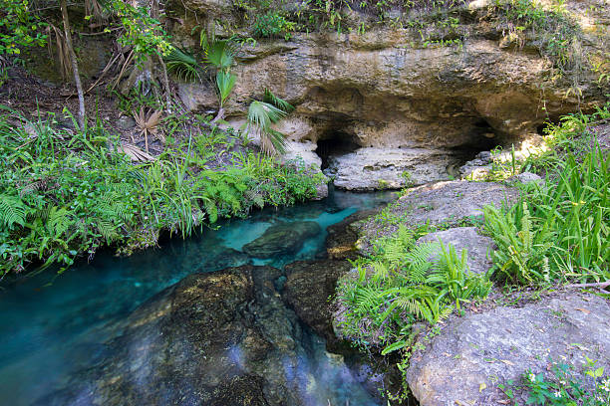
Limestone Caverns and Fresh Springs

Slide 21
Ancient Memories
Ages pass and you stay there in the dark for eons, with Osprey far above you squealing in the wind. Finally, the pressure of so many water drops filling that cavern BURST, exploding from the earth as a rush of water - becoming a freshwater spring - bringing life-giving water to the surface, you travel with that rush.
You keep flowing, following the southern incline of the Florida plateau - south and west toward the gulf. Some of the water drops become rivers, or flood out into the shallow basins that surround the rivers; others flood the forests and grassy plains in a stream of water, flowing and growing, following the cycle round and round from earth to sky and back again. You rise with the heat of the sun and join other water molecules in a dark cloud. Until you fall to the earth once again in a storm of rain.
You land in a grassy marsh and Osprey flies overhead, screeching in fun as he plays in a thermal of wind. Surrounding you are islands of land, high and dry hammocks - ancient “mountains' ' of sugary white sand and sediment gathered and placed by the prehistoric waves, bones of corals, and the peat of green leaves - islands in a sea of grass. On these islands, tall trees and climbing vines raise their faces to the power of the sun, growing taller and prouder, providing habitat for the creatures of this place.

Slide 22
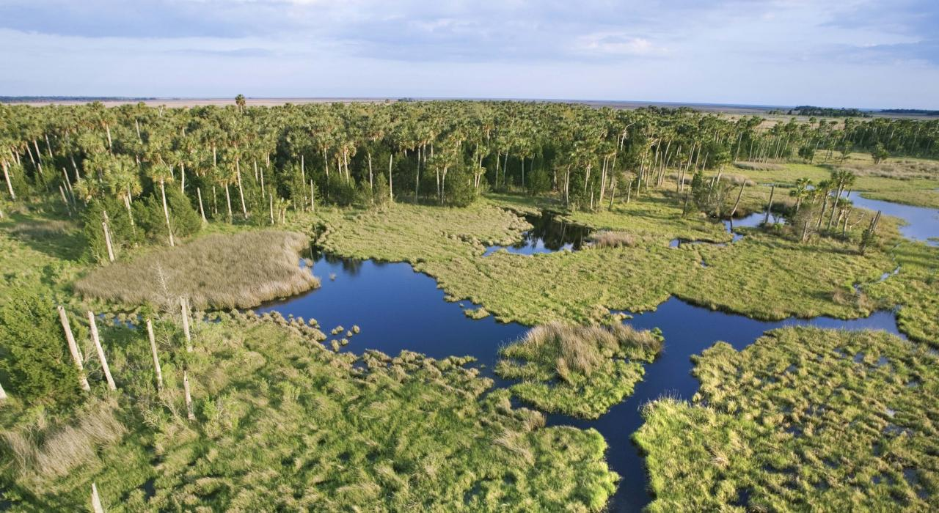
River of Grass and Islands of Trees

Slide 23
Cycle of Life
You become part of this place. What are you? An alligator, a bird, a fish, a crawfish, a snake, sawgrass, a cypress tree, a panther, a pine?
You and all the beings of this wet and dry land, both large and small, search for energy and shelter in the dirt around the tall pines, in the waters of the flooded noble cypress, in the high sugary sands surrounding the sharp palmettoes, and in the twisty, salty tangles of mangroves.
You and Osprey travel, heading east.
You come to the sandy shore of a shallow sea. Just off-shore, where the land dips, the reefs are growing like lego blocks - coral polyps living and dying, stacking their bones on each other.
Ages pass, and there we are again, in the shallows of the warm, azure sea. The cycle of life on earth continuing its travels around the sun.

Slide 24
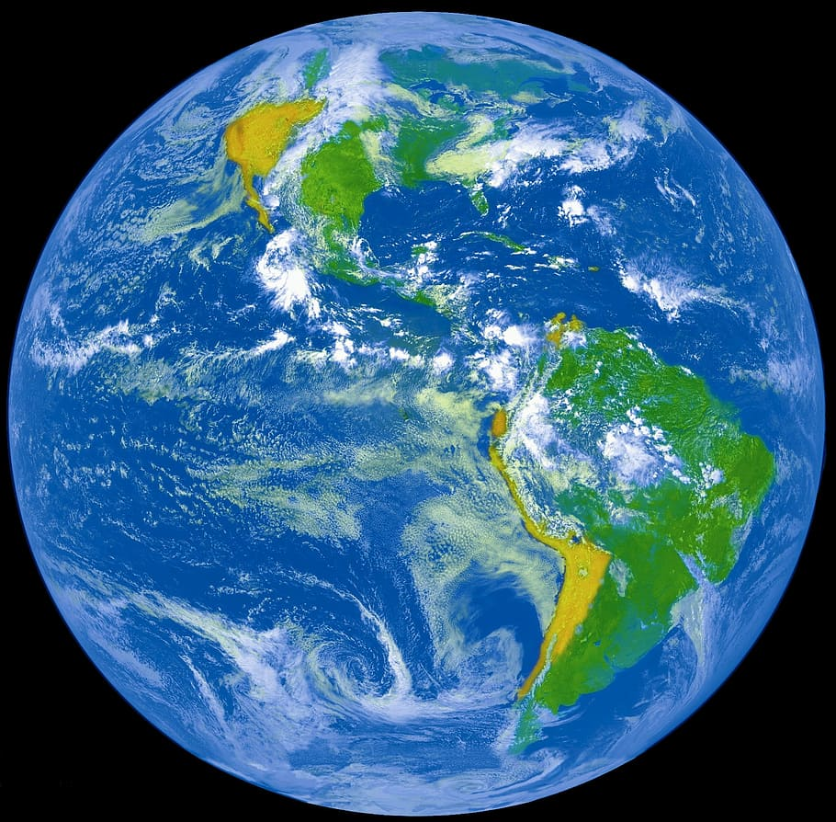
Connected, Connected
Connected, connected
Everything’s connected
To everything else
Habitat, habitat, have to have a habitat
Habitat, habitat, have to have a habitat
Habitat, it’s where it’s at

Slide 25
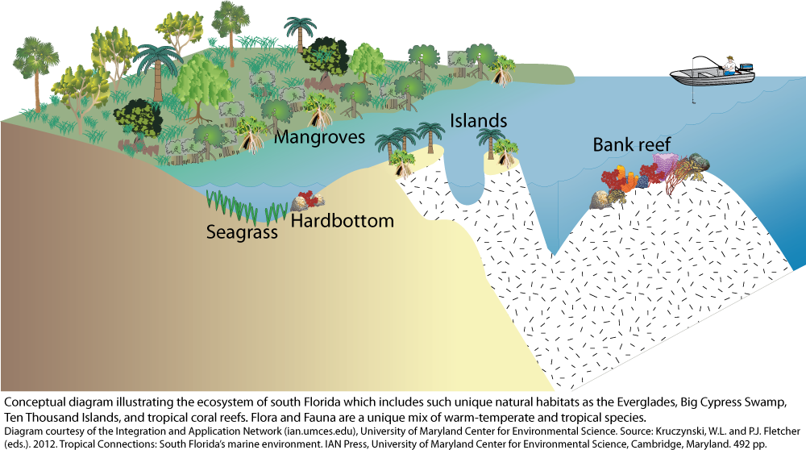
ADVENTURE…Go ECO -EVERY CHILD OUTSIDE! Time to head out to the 4 Corners & Discover Florida! Infuse your learning with nature and place based education wherever you are learning!

Slide 26
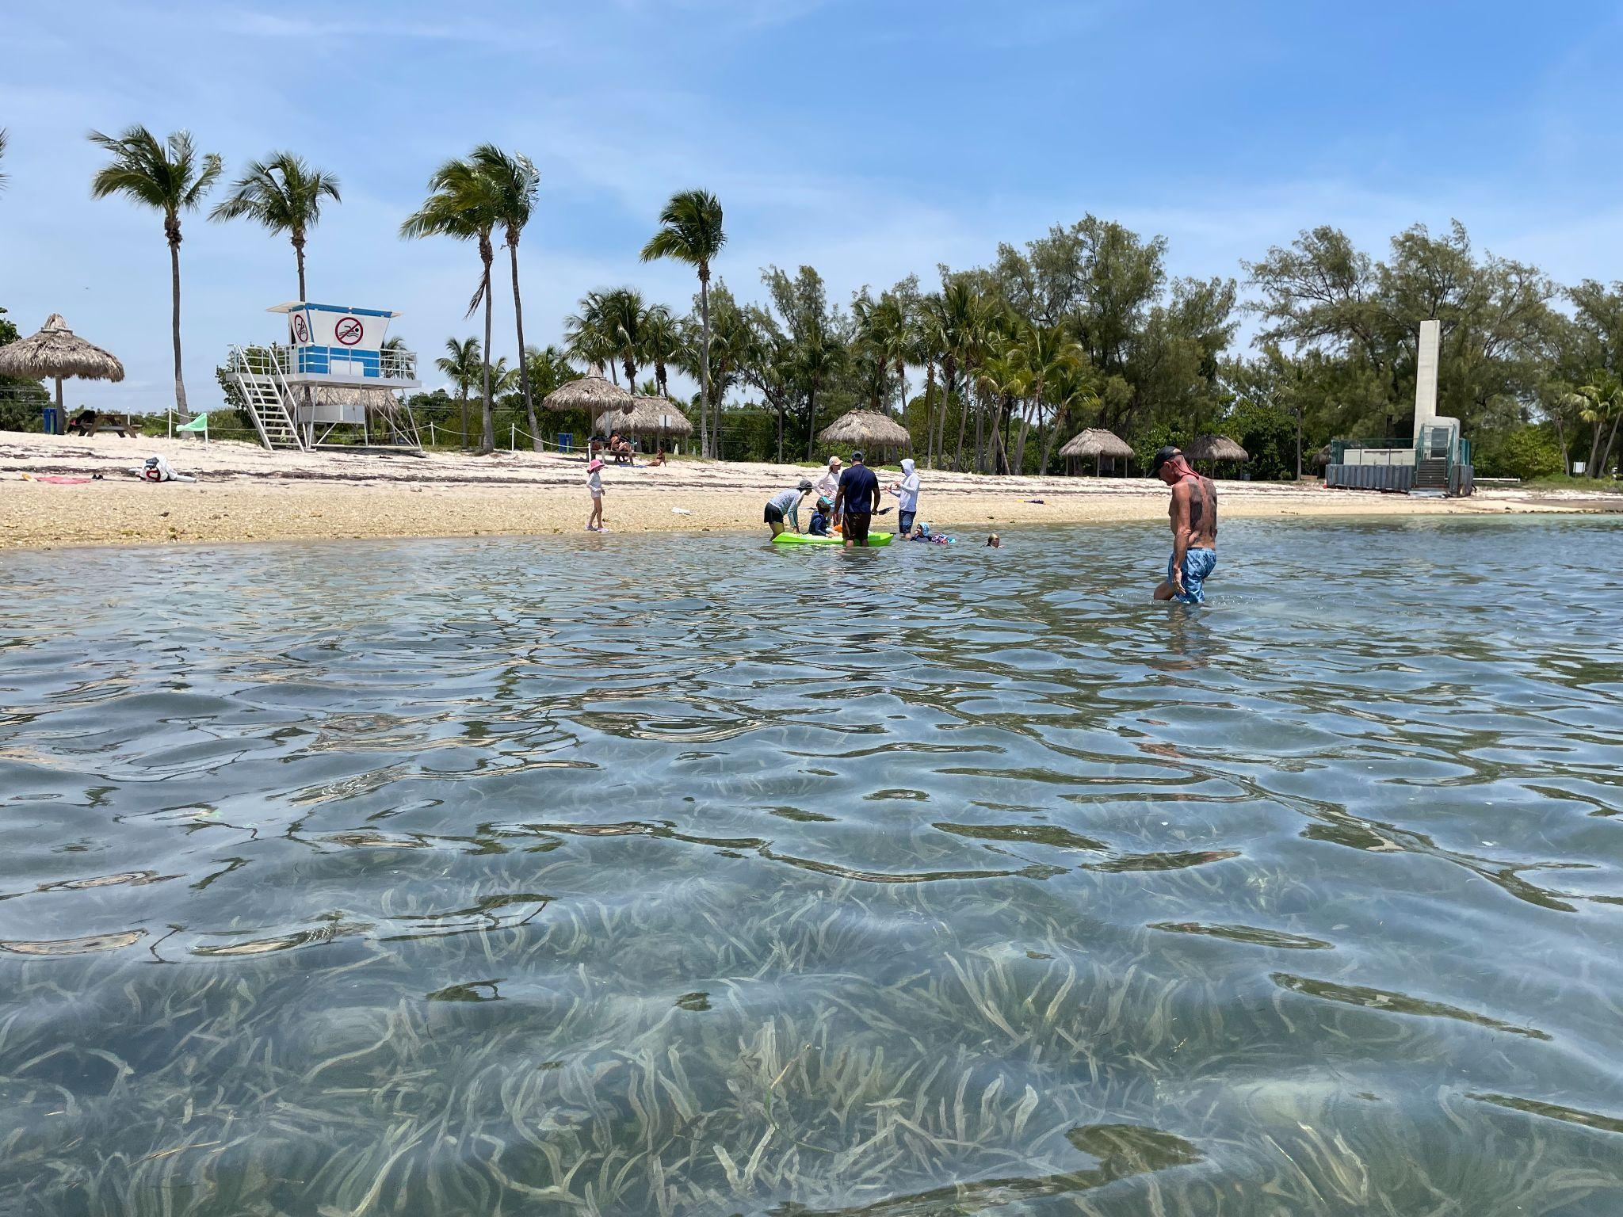
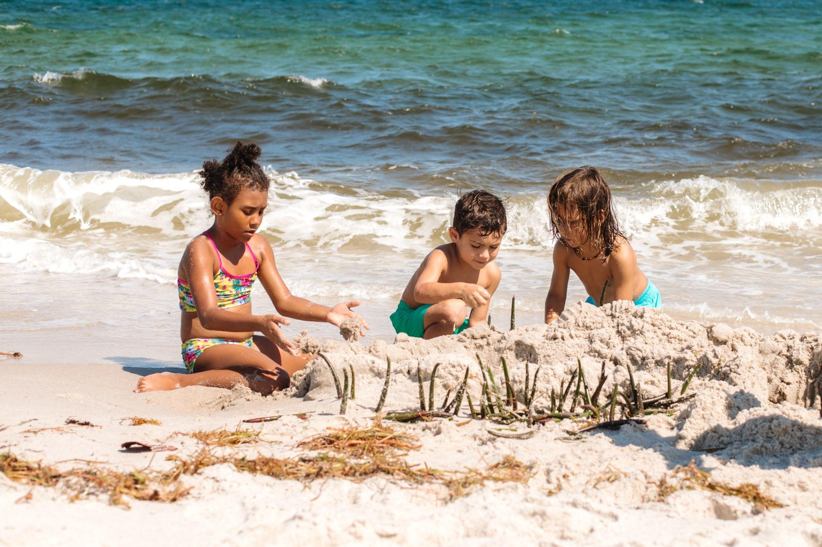
To the Sea…Coastal Ecosystems
Mizell-Johnson State Beach - Beach Days
Virginia Key = Seagrass Adventure

Slide 27
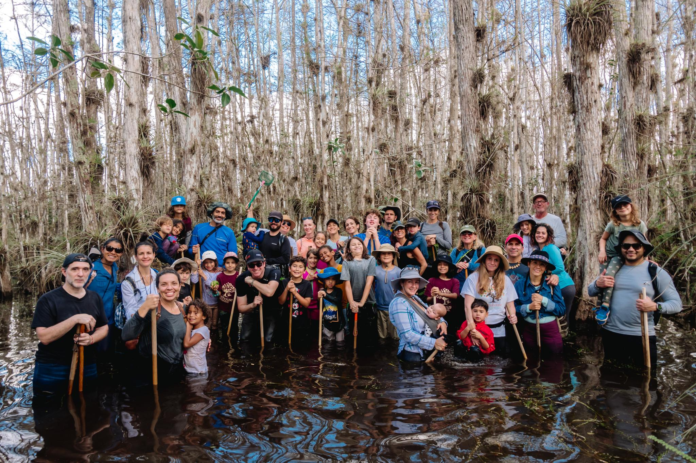
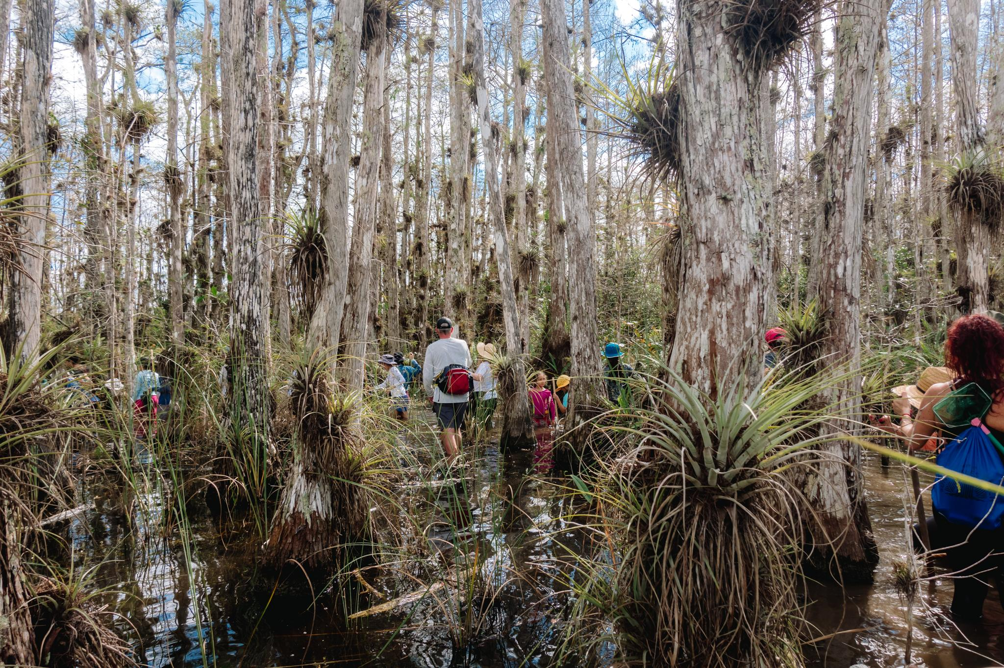
Water, Water, Everywhere…Wetland Ecosystems
Big Cypress National Preserve - Swampin It!

Slide 28
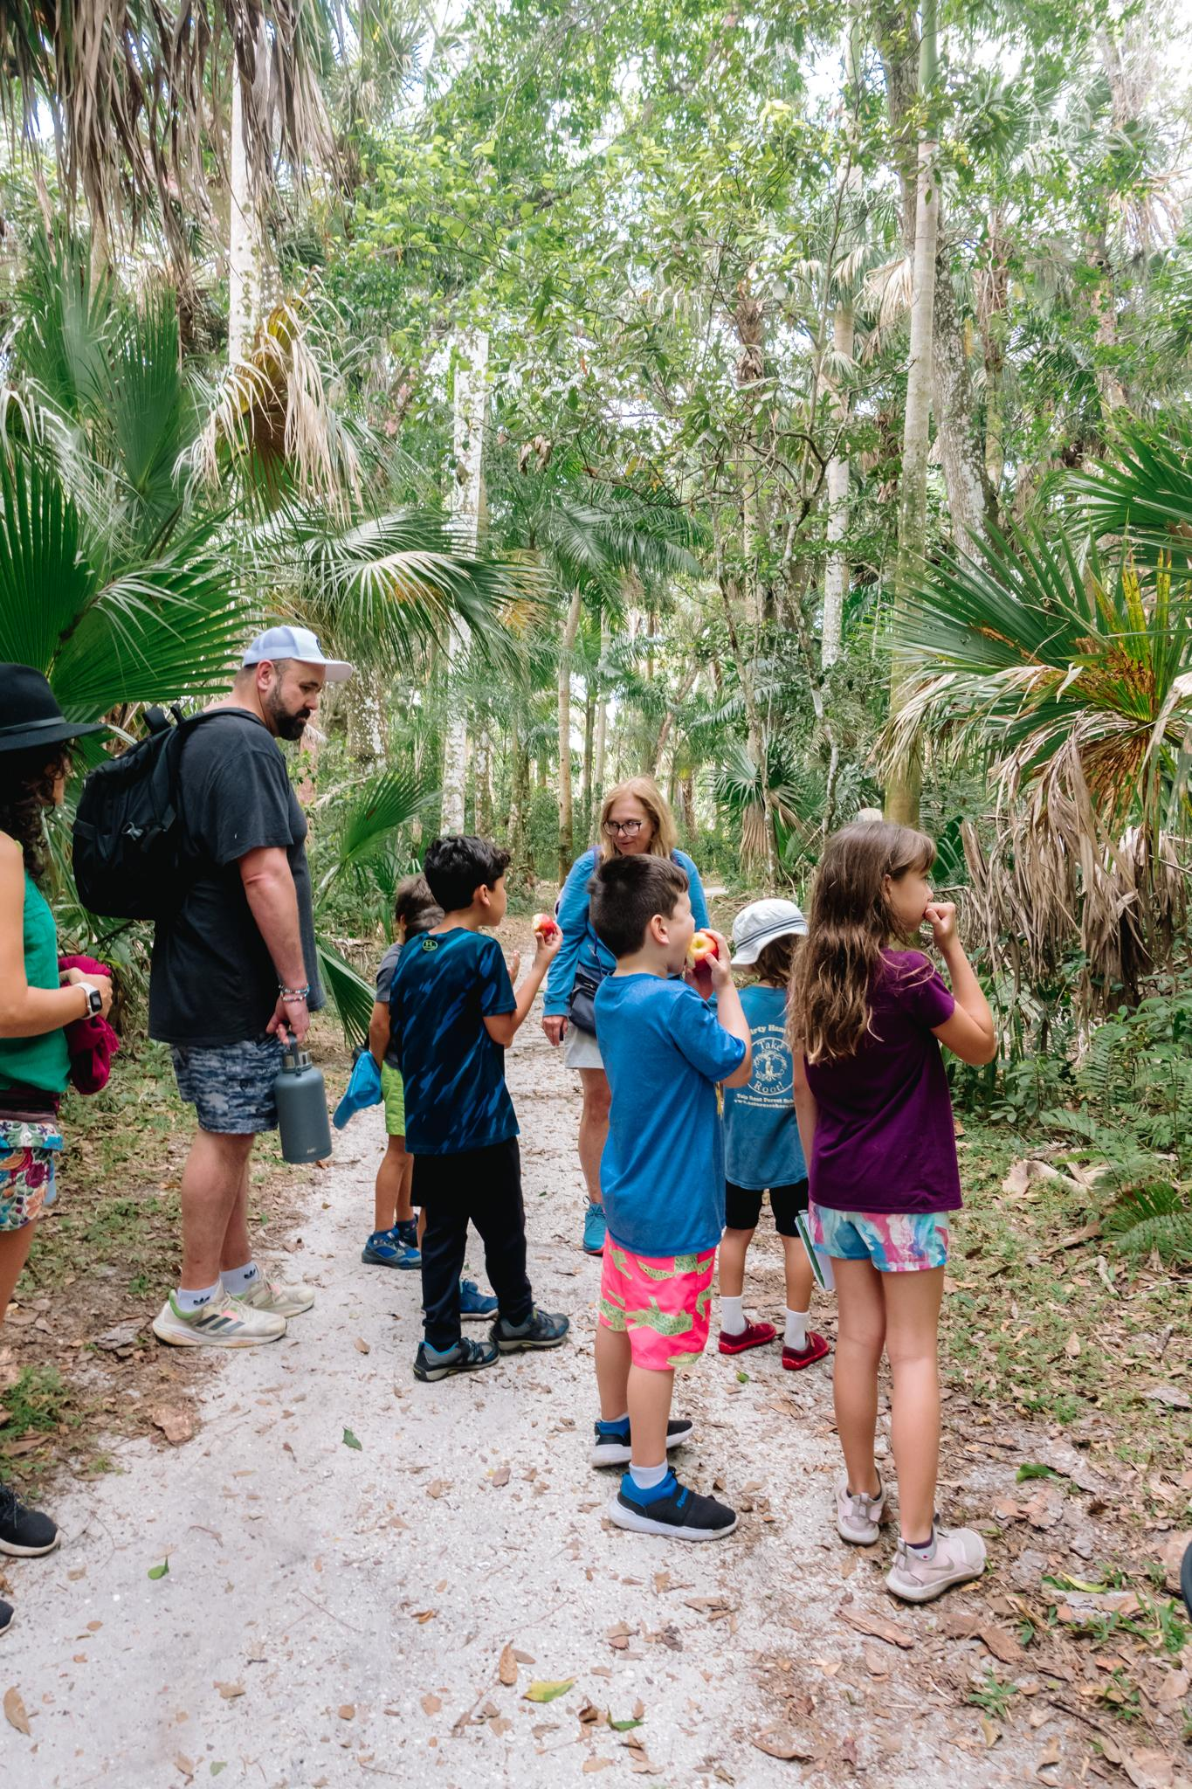
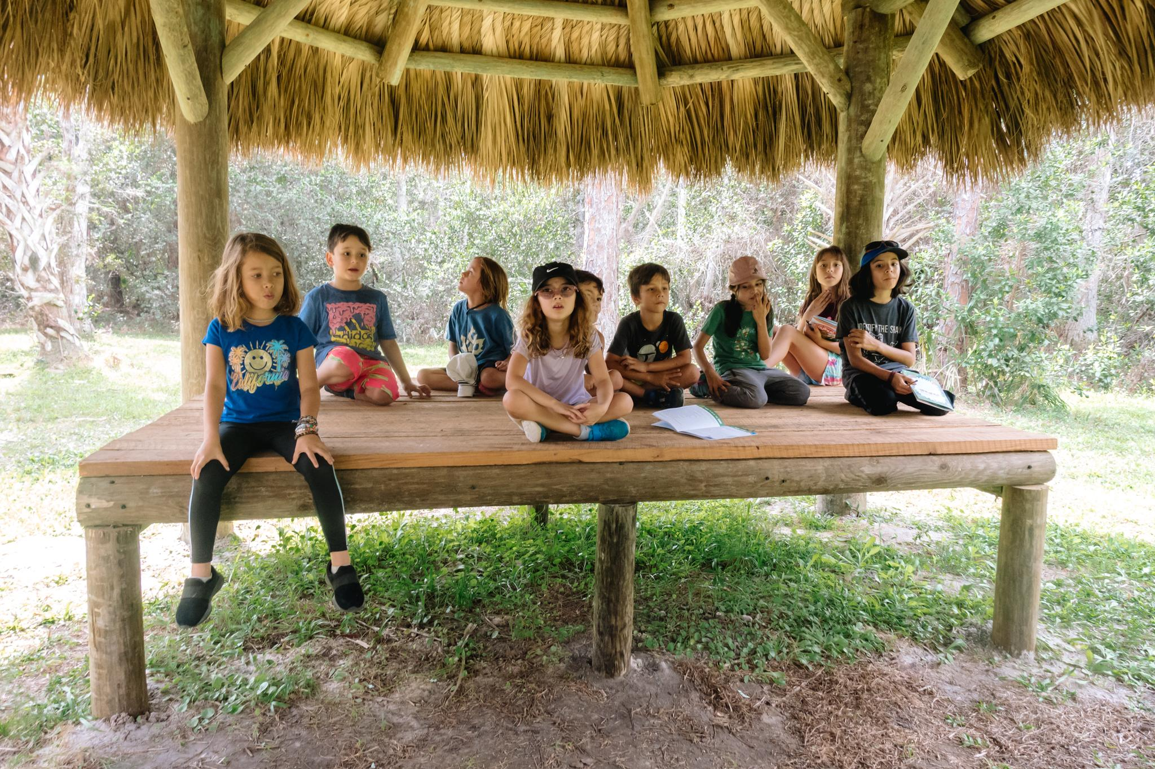
High and Dry…Upland Ecosystems
Riverbend Park - Upland Scrub and Hammock

Slide 29
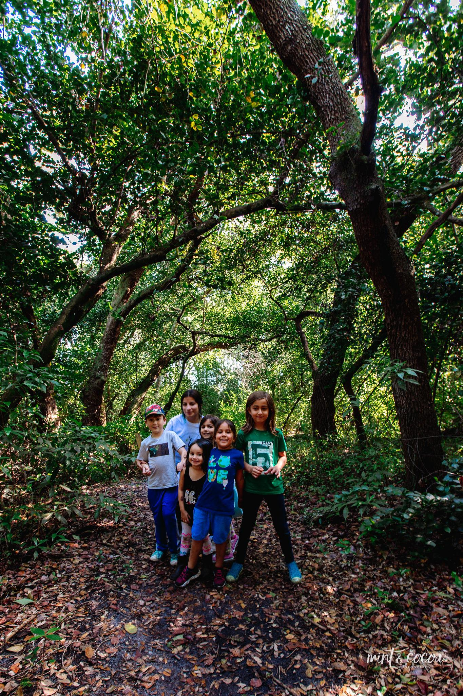
Take Root Forest School
Education for the Whole Child…Head, Heart & Hands in the Forest and by the Sea

Slide 30
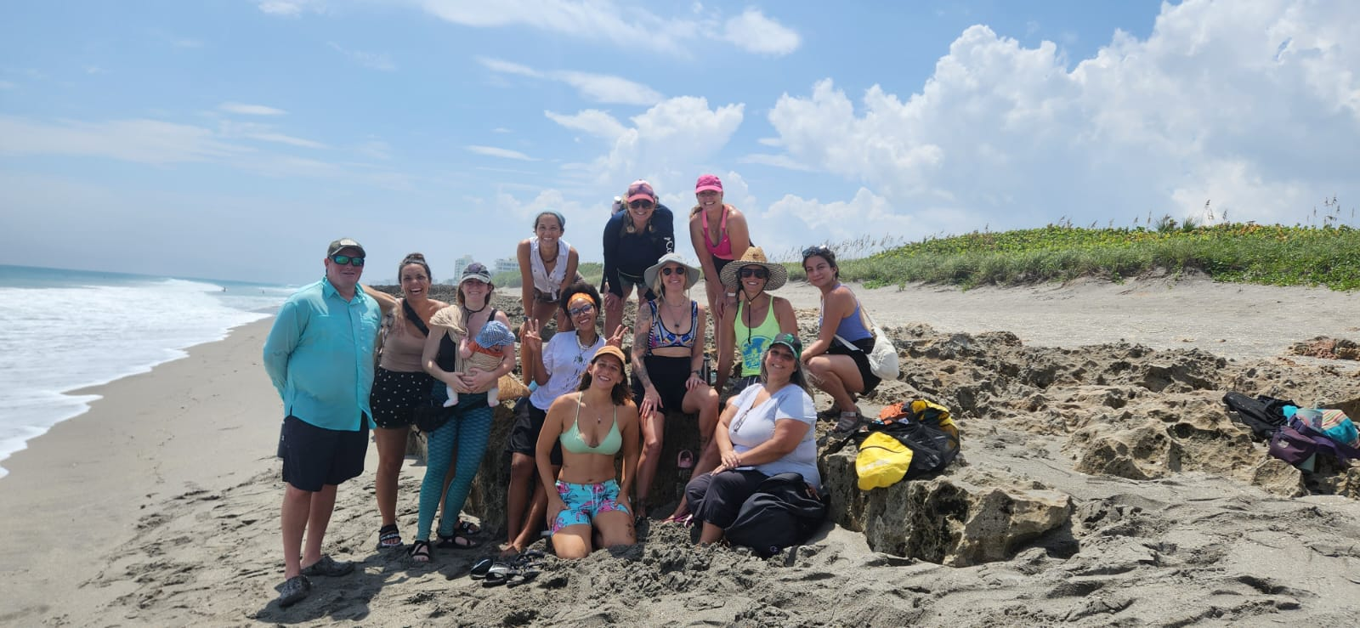

Slide 31
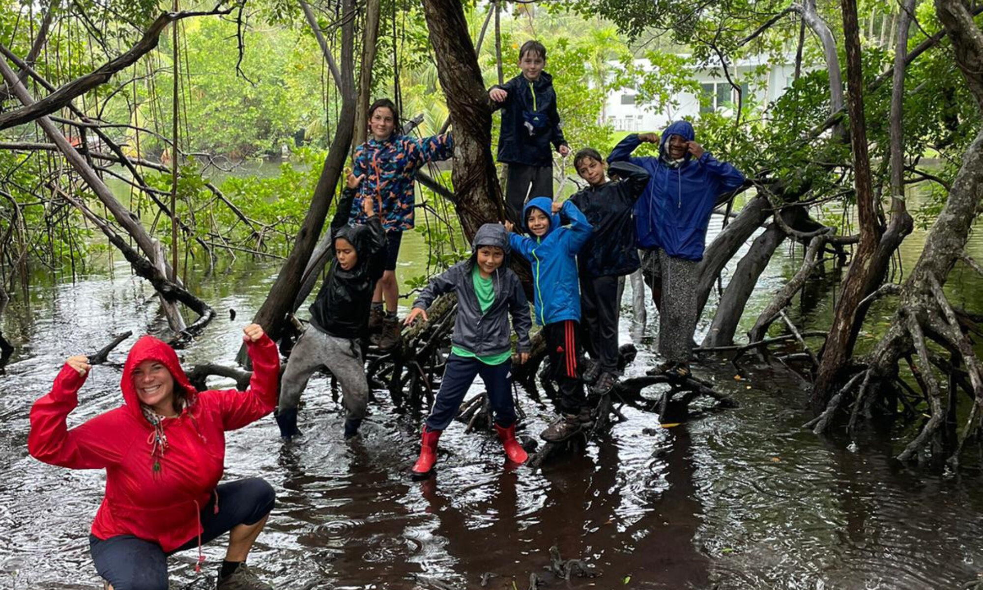

Slide 32
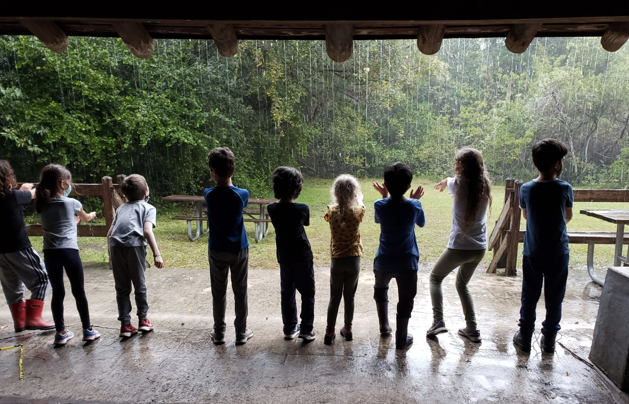

Slide 33
